Slide 1

ISE 218: Fundamentals of Information Technology Unit 8: Network Organization and Architecture
Spring 2025
Instructor: Abid Malik
co-Instructor: Xinrui Yu

Slide 2
Introduction
The network is a crucial component of today’s computing systems.
Resource sharing across networks has taken the form of multitier architectures having numerous disparate servers, sometimes far removed from the users of the system.
If you think of a computing system as collection of workstations and servers, then surely the network is the system bus of this configuration.

Slide 3
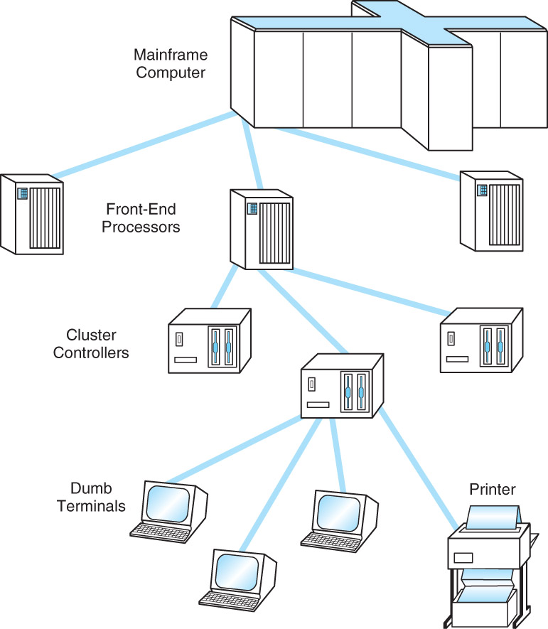
Early Business Computer Networks
The first computer networks consisted of a mainframe host that was connected to one or more front-end processors.
Front-end processors received input over dedicated lines from remote communications controllers connected to several dumb terminals.
The protocols employed by this configuration were proprietary to each vendor’s system.
One of these, IBM’s Systems Network Architecture, became the model for an international communications standard, the ISO/OSI Reference Model.

Slide 4
Early Academic and Scientific Networks
In the 1960s, the Advanced Research Projects Agency funded research under the auspices of the U.S. Department of Defense.
Computers at that time were few and costly. In 1968, the Defense Department funded an interconnecting network to make the most of these precious resources.
The network, ARPANet, had sufficient redundancy to withstand the loss of a good portion of the network.
ARPANet, later turned over to the public domain, eventually evolved to become today’s Internet.
In 1985, the National Science Foundation launched NSFnet to support scientific and academic research
It absorbed ARPANet, thereby creating the Internet, which is an internetwork (a network of networks)

Slide 5
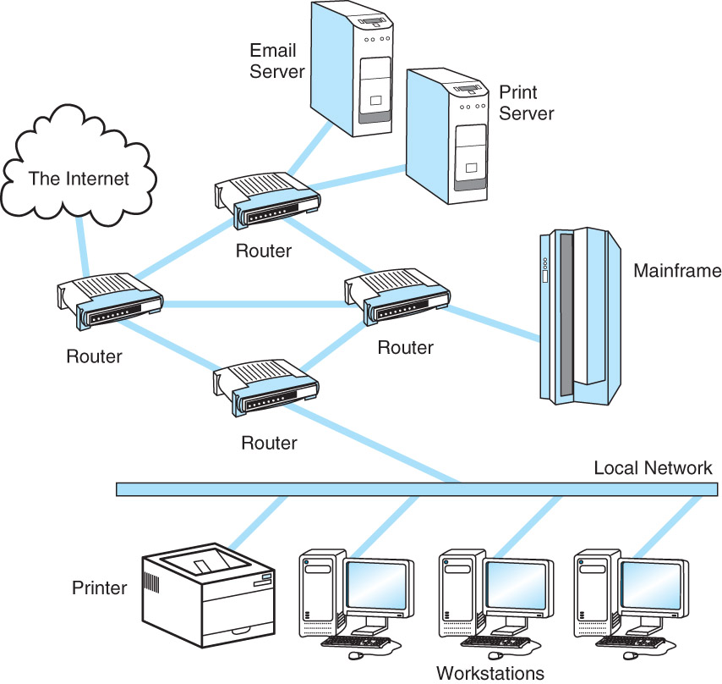
Early Academic and Scientific Networks
The figure on the right shows an example of an internetwork
The ARPANet’s communication methods were designed to withstand a nuclear attack by sending data in independently-routed datagram message packets, not streams (more on this later)
In the 1990s, telecom companies bought the high-speed backbone lines of the Internet and made (and make) money selling capacity to Internet Service Providers

Slide 6
ISO/OSI Reference Model
To address the growing tangle of incompatible proprietary network protocols, in 1984 the ISO formed a committee to devise a unified, open (non-proprietary) protocol standard.
The result of this effort is the ISO Open Systems Interconnect Reference Model (ISO/OSI RM).
The ISO’s work is called a reference model because virtually no commercial system uses all of the features precisely as specified in the model.
The ISO/OSI model does, however, lend itself to understanding the concept of a unified communications architecture.

Slide 7
ISO/OSI Reference Model
The OSI protocol stack defines seven layers of responsibility of the network communication scheme
From top-to-bottom, the layers are named as follows:
Application, Presentation, Session, Transport, Network, Data Link, Physical
Each layer is allowed to communicate only with the layer immediately above and/or below it
This separation of the protocols into layers helps to clearly define and modularize the specific functions and responsibilities that are required in network communication
The OSI model defines only the functions of each of the seven layers and the interfaces between them.
Implementation details are not part of the model.

Slide 8
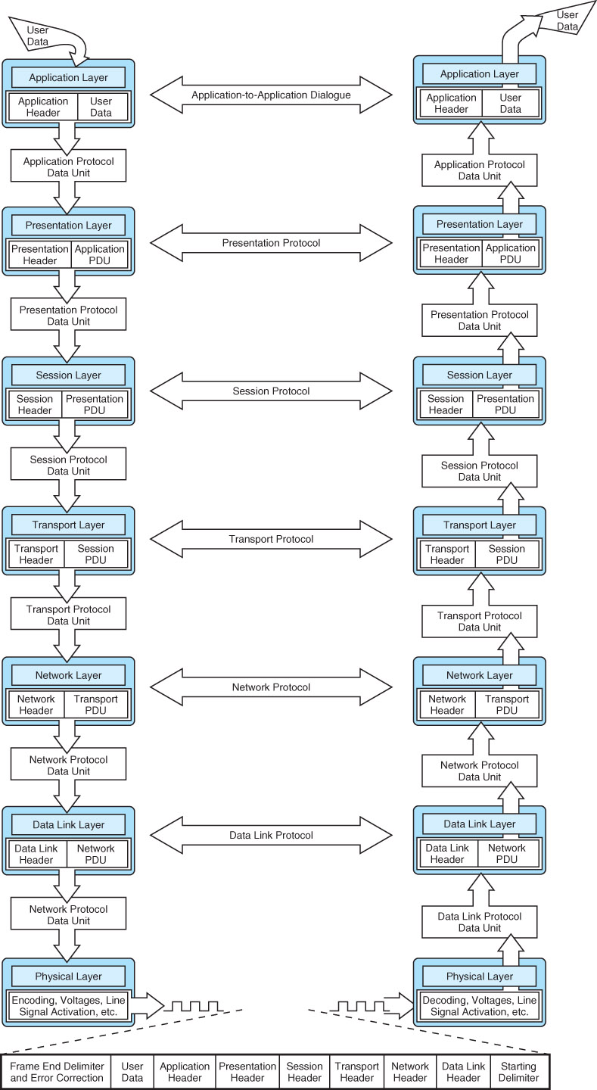
ISO/OSI Reference Model (top 4 layers)

Slide 9
ISO/OSI Reference Model (bottom 3 layers)

Slide 10
ISO/OSI Reference Model
The basic unit of data in the OSI model is the protocol data unit (PDU)
Each layer communicates to the next through a clearly defined service access point (SAP)
Each layer adds its own data to the PDU before passing it up to the next higher layer
Likewise, as a PDU travels down the protocol stack, each layer strips off its layer-dependent data and passes the now-smaller PDU down to the next layer

Slide 11
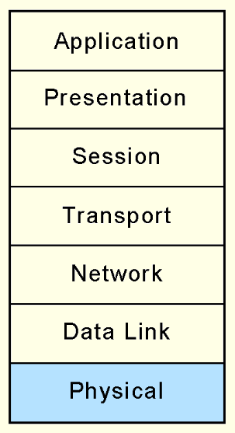
ISO/OSI Model: Physical Layer
The Physical layer receives a stream of bits from the Data Link layer above it, encodes them, and places them on the communications medium.
The Physical layer conveys transmission frames, called Physical Protocol Data Units, or Physical PDUs.
Each physical PDU carries an address and has delimiter signal patterns that surround the payload, or contents, of the PDU.
Examples of physical transmission media could include wireless, copper, satellite and optical fiber
This layer is concerned primarily with the transmission of raw bits over the communication medium

Slide 12
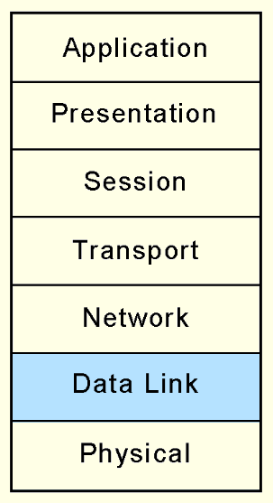
ISO/OSI Model: Data Link Layer
The Data Link layer negotiates frame sizes and the speed at which they are sent with the Data Link layer at the other end.
The timing of frame transmission is called flow control.
Data Link layers at both ends acknowledge packets as they are exchanged. The sender retransmits the packet if no acknowledgement is received within a given time interval.

Slide 13
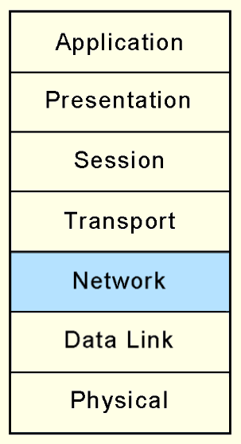
ISO/OSI Model: Network Layer
At the originating computers, the Network layer adds addressing information to the Transport layer PDUs.
The Network layer establishes the route and ensures that the PDU size is compatible with all of the equipment between the source and the destination.
Its most important job is in moving (routing) PDUs across intermediate nodes.

Slide 14
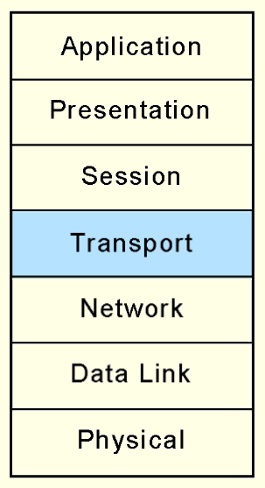
ISO/OSI Model: Transport Layer
The OSI Transport layer provides end-to-end acknowledgement and error correction through its handshaking with the Transport layer at the other end of the conversation.
The Transport layer is the lowest layer of the OSI model at which there is any awareness of the network or its protocols.
The Transport layer assures the Session layer that there are no network-induced errors in the PDU.
The Transport layer must break the messages into smaller units (frames), prepending a header to each frame to form the Transport layer PDU

Slide 15
ISO/OSI Model: Transport Layer
The Session layer above the Transport layer can thereby (1) send/receive large messages of whatever size it wants and (2) do so without worry about data loss
The Transport layer handles both issues

Slide 16
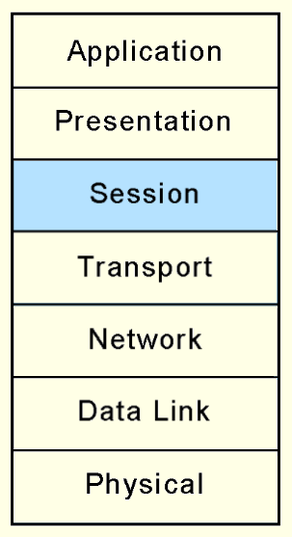
ISO/OSI Model: Session Layer
The Session layer arbitrates the dialogue between two communicating nodes, opening and closing that dialogue as necessary.
It controls the direction and mode (half-duplex or full-duplex).
Half-duplex: communication travels only in one direction
Full-duplex: communication travels in both directions
It also supplies recovery checkpoints during file transfers.
Checkpoints are issued each time a block of data is acknowledged as being received in good condition.
In this way, if the connection is completely lost, it can be resumed

Slide 17
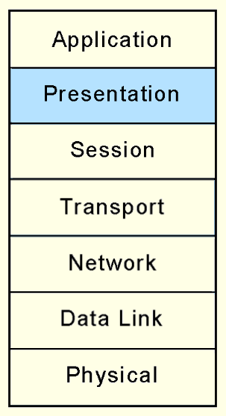
ISO/OSI Model: Presentation Layer
The Presentation layer provides high-level data interpretation services for the Application layer above it, such as EBCDIC-to-ASCII translation.
Presentation layer services are also called into play if we use encryption or certain types of data compression.

Slide 18
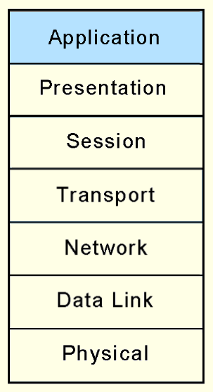
ISO/OSI Model: Application Layer
The Application layer supplies meaningful information and services to users at one end of the communication and interfaces with system resources (programs and data files) at the other end of the communication.
All that applications need to do is to send messages to the Presentation layer, and the lower layers take care of the hard part.

Slide 19
ISO/OSI Reference Model
“All people seem to need data processing.”
Application
Presentation
Session
Transport
Network
Data Link
Physical

Slide 20
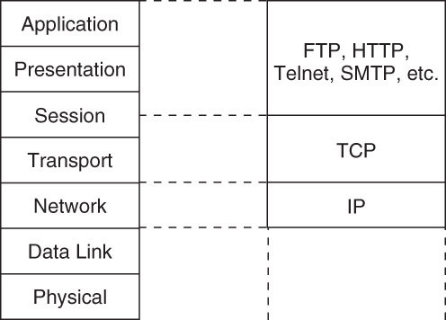
TCP/IP Network Architecture
TCP/IP is the de facto global data communications standard.
It has a lean 3-layer protocol stack that can be mapped to five of the seven in the OSI model.
TCP/IP can be used with any type of network, even different types of networks within a single session.

Slide 21
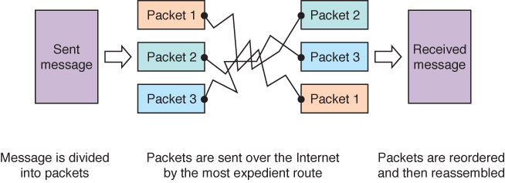
TCP/IP Network Architecture
The IP Layer of the TCP/IP protocol stack provides essentially the same services as the Network and Data Link layers of the OSI Reference Model.
It divides TCP packets into protocol data units called datagrams, and then attaches routing information.

Slide 22
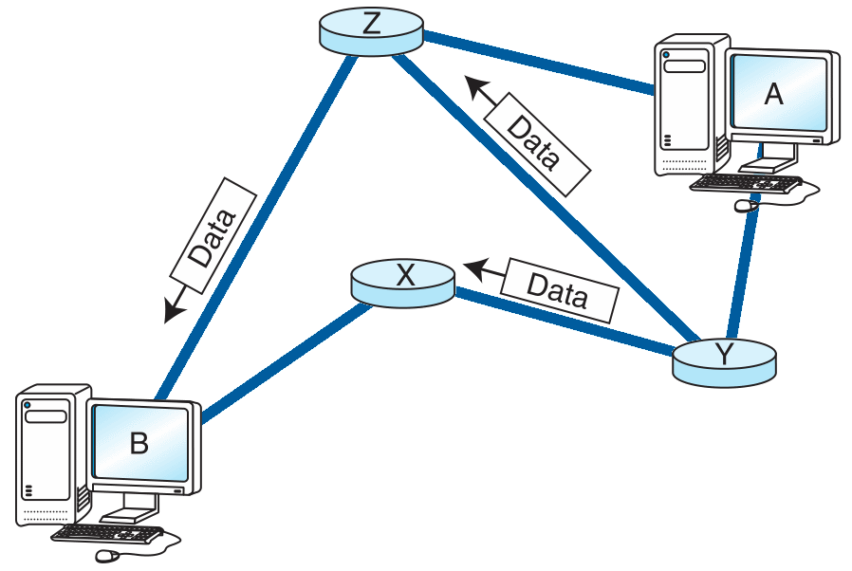
TCP/IP Network Architecture
The concept of the datagram was fundamental to the robustness of ARPAnet, and now, the Internet.
Datagrams can take any route available to them without human intervention.

Slide 23
TCP/IP Network Architecture
The older version of IP, IPv4, was never designed to serve millions of network components scattered across the globe.
It limitations include 32-bit addresses, a packet length limited to 65,635 bytes, and that all security measures are optional.
Furthermore, network addresses have been assigned with little planning, which has resulted in slow and cumbersome routing hardware and software.
We will see later how these problems have been addressed by IPv6.
A 32-bit IPv4 network address is given in dotted notation consisting of four integers in the range 0 through 255, separated by spaces.
Examples: 192.16.4.99 and 244.22.3.155
Each integer can be expressed using 8 bits, or 1 byte
Since we have four of these numbers, we have 4 x 8 = 32 bits of the IP address

Slide 24
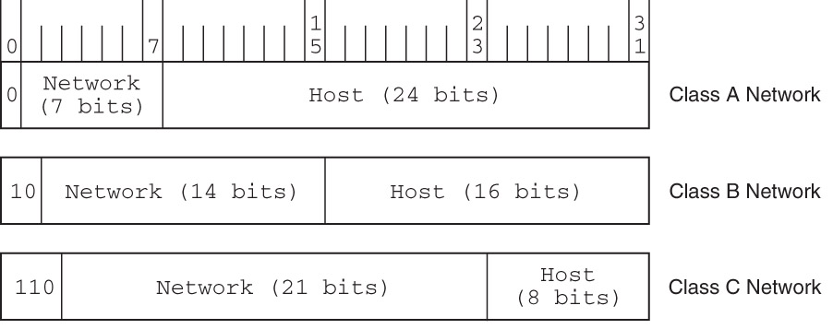
IPv4 Address Space
The IPv4 Address Space is divided into five different classes (only three shown here)
A network’s class determines the maximum number computers that could be on that network

Slide 25
IPv4 Address Space
What is the maximum number of hosts that can be defined in a class A network?
Answer: 2²⁴

Slide 26
IPv4 Address Space
A computer has the IP address 221.15.220.192
What network class does it belong to?
Answer: 221₁₀ = 11011101₂, so class C

Slide 27
TCP/IP Network Architecture
Transmission Control Protocol (TCP) is the consumer of IP services.
It engages in a conversation – a connection – with the TCP process running on the remote system.
A TCP connection is analogous to a telephone conversation, with its own protocol “etiquette.”
As part of initiating a connection, TCP also opens a service access point (SAP) in the application running above it.
In TCP, this SAP is a numerical value called a port.

Slide 28
TCP/IP Network Architecture
The combination of the port number, the host ID, and the protocol designation becomes a socket.
The program can “read” data from and “write” data to the socket as though it were reading or writing data to a file on disk.
Port numbers 0 through 1023 are called “well-known” port numbers because they are reserved for particular TCP applications.
The two computers negotiate a congestion window size, which is the number of bytes to send between acknowledgments.
When the recipient receives a TCP segment, it sends back an acknowledgment to the sender
If the sender of a message does not receive an acknowledgement for a segment, it retransmits the segment

Slide 29
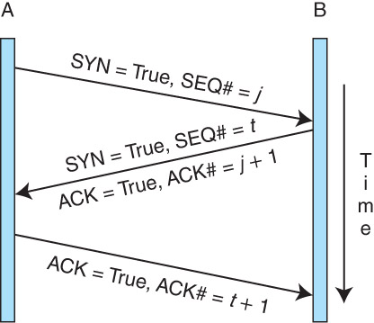
Communication via TCP
TCP initiates a communication session using a handshake
The figure shows an example of a three-way handshake
The two starting sequence numbers ( j and t in the figure) are typically chosen at random by the two systems (for sake of security)

Slide 30
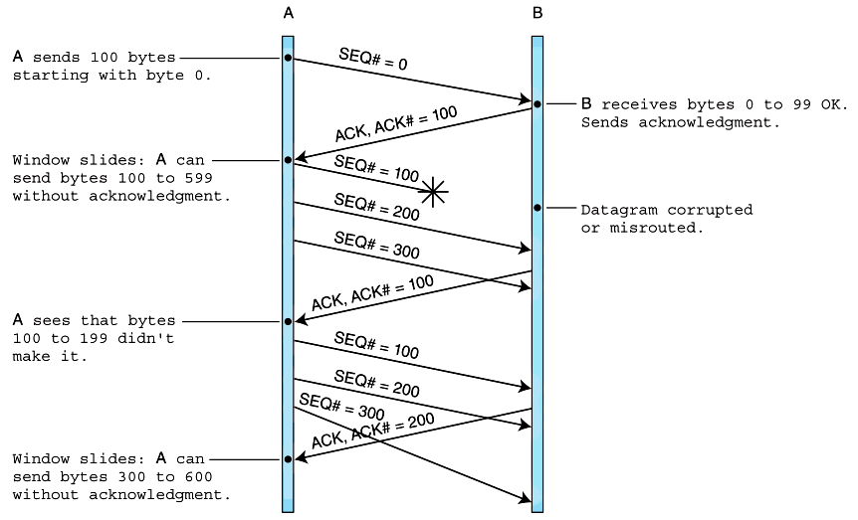
Communication via TCP: Example #1
TCP data exchange
100-byte payloads with 500-byte windows

Slide 31
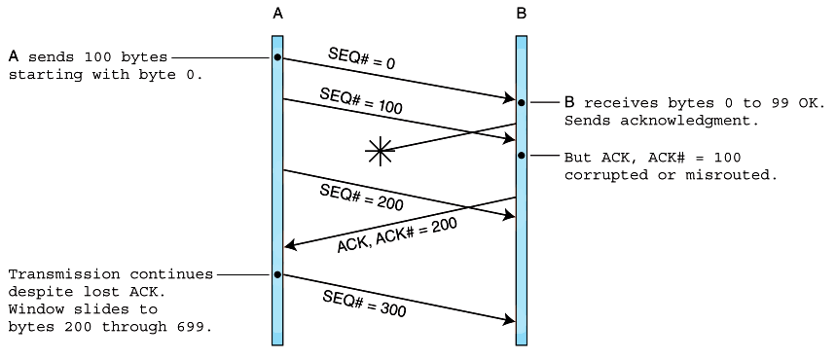
Communication via TCP: Example #2
TCP data exchange with lost acknowledgement
A later ACK prevents retransmission of lost one

Slide 32
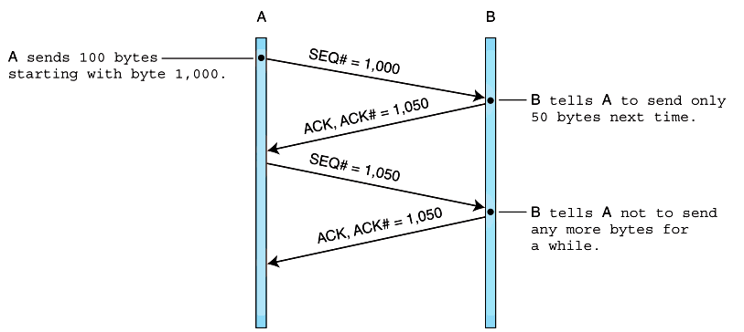
Communication via TCP: Example #3
TCP flow control example. Flow control is performed using acknowledgment numbers.

Slide 33
TCP Windows: Example #1
Two stations running TCP/IP are engaged in transferring a file. This file is 100K long, the payload size is 100 bytes, and the negotiated congestion window size is 300 bytes. The sender receives an ACK 1500 from the receiver.
Which bytes will be sent next?
Answer: bytes 1500 through 1599

Slide 34
TCP Windows: Example #2
Two stations running TCP/IP are engaged in transferring a file. This file is 100KB long, the payload size is 100 bytes, and the negotiated congestion window size is 300 bytes. The sender receives an ACK 1500 from the receiver.
What is the last byte number that can be sent without an ACK being sent by the receiver?
Answer: byte 1799

Slide 35
TCP/IP Network Architecture
To terminate a connection, one of the parties sends a segment with a FIN message
If the recipient acknowledges the FIN, the connection is closed
Otherwise, the sender waits until a negotiated timeout period elapses and closes the connection on its own

Slide 36
TCP Congestion Control
The TCP window size can be adjusted dynamically, over time (during exchange of messages) to help with congestion control
If the sender is transmitting data faster than the receiver can process it, packets will be dropped (lost)
The congestion window size can then be decreased so that fewer bytes are sent at a time
TCP uses the congestion control scheme known as additive-increase/multiplicative-decrease (AIMD)
The idea is simple, yet effective: if no packets are lost during one round-trip between the sender and receiver, the window size can be increased by some small, fixed amount (“additive increase”)
But if packets are lost, the window size can be reduced by a large fraction, such as one-half (“multiplicative decrease”)

Slide 37
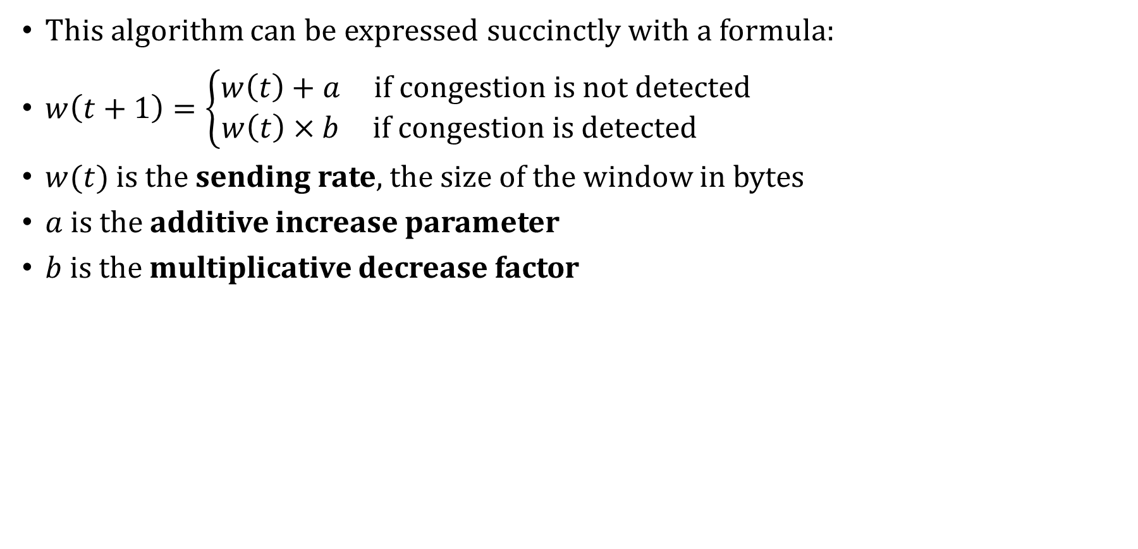
TCP Congestion Control
This algorithm can be expressed succinctly with a formula:
$w\left(t+1\right)=\left\{\begin{matrix}w\left(t\right)+a & if congestion is not detected \\ w\left(t\right)×b & if congestion is detected \end{matrix}\right.$
$w(t)$ is the sending rate, the size of the window in bytes
$a$ is the additive increase parameter
$b$ is the multiplicative decrease factor

Slide 38
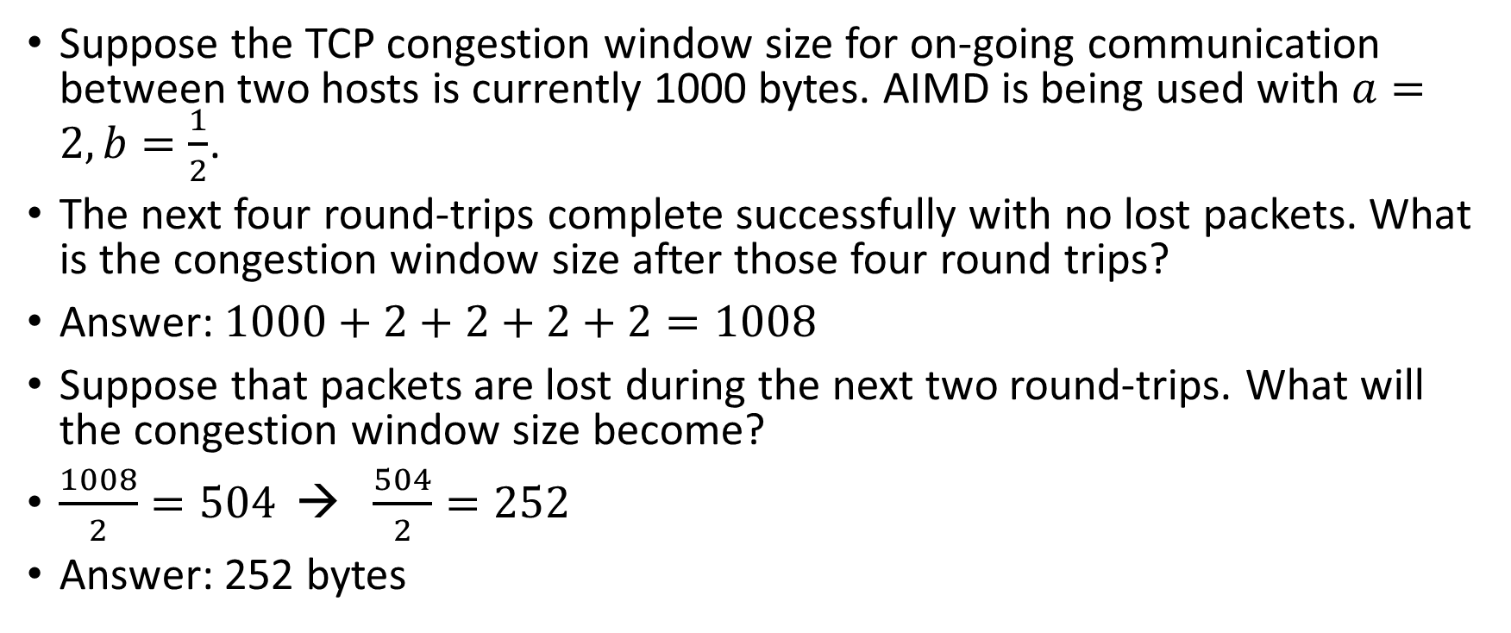
TCP Congestion Control: Example
Suppose the TCP congestion window size for on-going communication between two hosts is currently 1000 bytes. AIMD is being used with $a=2, b=\frac{1}{2}$.
The next four round-trips complete successfully with no lost packets. What is the congestion window size after those four round trips?
Answer: $1000+2+2+2+2=1008$
Suppose that packets are lost during the next two round-trips. What will the congestion window size become?
$\frac{1008}{2}=504$ → $\frac{504}{2}=252$
Answer: 252 bytes

Slide 39
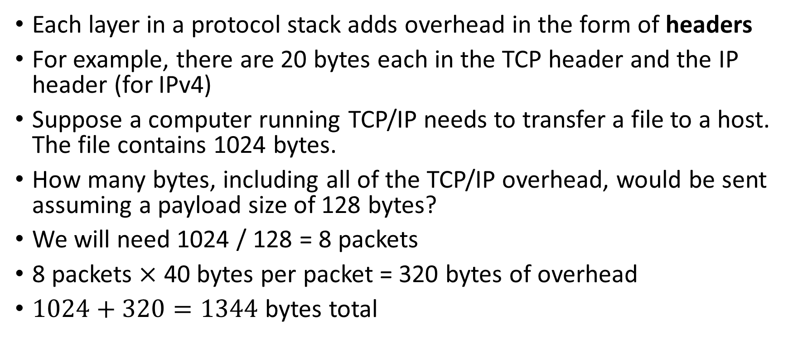
Protocol Overhead: Example
Each layer in a protocol stack adds overhead in the form of headers
For example, there are 20 bytes each in the TCP header and the IP header (for IPv4)
Suppose a computer running TCP/IP needs to transfer a file to a host. The file contains 1024 bytes.
How many bytes, including all of the TCP/IP overhead, would be sent assuming a payload size of 128 bytes?
We will need 1024 / 128 = 8 packets
8 packets $×$ 40 bytes per packet = 320 bytes of overhead
$1024+320=1344$ bytes total

Slide 40
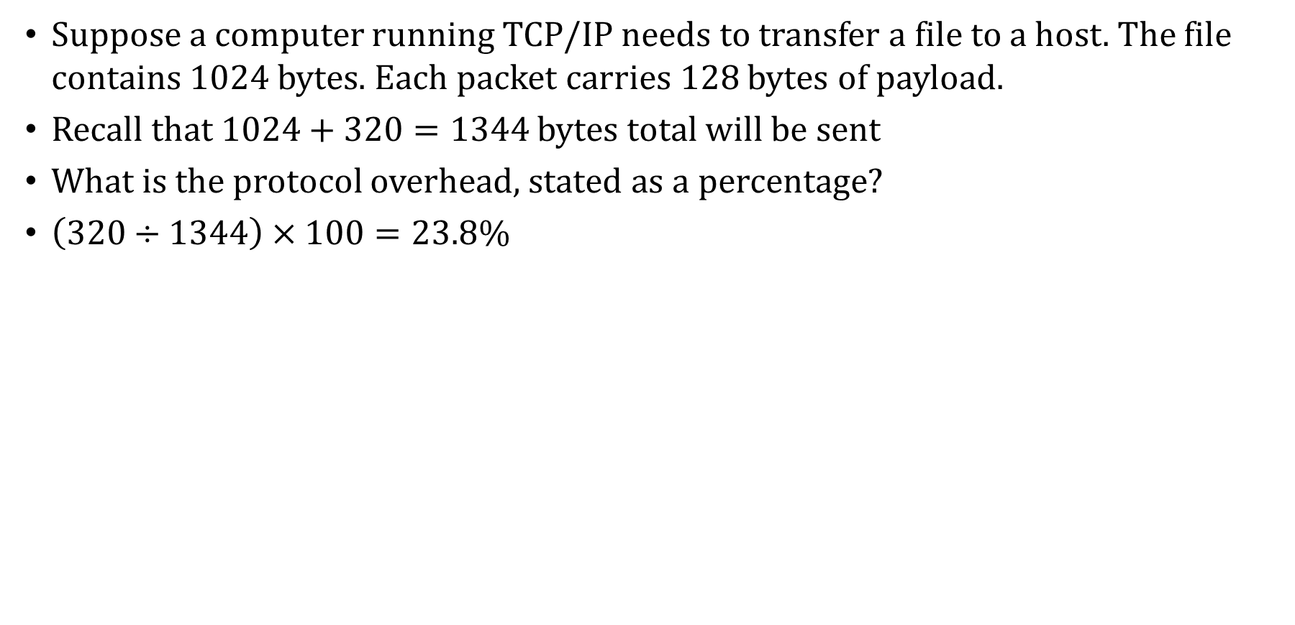
Protocol Overhead: Example (cont.)
Suppose a computer running TCP/IP needs to transfer a file to a host. The file contains 1024 bytes. Each packet carries 128 bytes of payload.
Recall that $1024+320=1344$ bytes total will be sent
What is the protocol overhead, stated as a percentage?
$\left(320÷1344\right)×100=23.8\%$

Slide 41
IP Version 6
In 1994, the Internet Engineering Task Force began work on what is now IP Version 6.
The IETF’s primary motivation in designing a successor to IPv4 was to extend IP's address space beyond its current 32-bit limit to 128 bits for both the source and destination host addresses.
This is a seemingly inexhaustible address space, giving 2¹²⁸ possible host addresses.
IPv6 packets can be tagged as being part of real-time transmission (e.g., voice) and thereby be given higher priority on the network
IPv4 is very insecure. IPv6 supports encryption and other security features (e.g., prevents address spoofing)

Slide 42
IP Version 6
Most modern Internet routers are dual stack, supporting both IPv4 and IPv6 communication, which is helping the transition to IPv6
IPv6 also incorporates better geographic assignment of IP address ranges
The IPv4 address space is distributed haphazardly, which complicates traffic routing

Slide 43
Domain Name System
IP addresses are needed for two computers on the Internet to communicate
But, host names like www.stonybrook.edu are easier to work with
Domain Name System (DNS) is the system used on the Internet to map host names to IP addresses
When your computer wants to contact another computer by host name, your computer will contact a nearby DNS server and ask it to resolve (translate) the name
If that server doesn’t know the mapping, it in turn will ask another DNS server, and so on, until the host name can be resolved into an IP address
That IP address is sent to your computer to help it initiate communication with the remote host

Slide 44
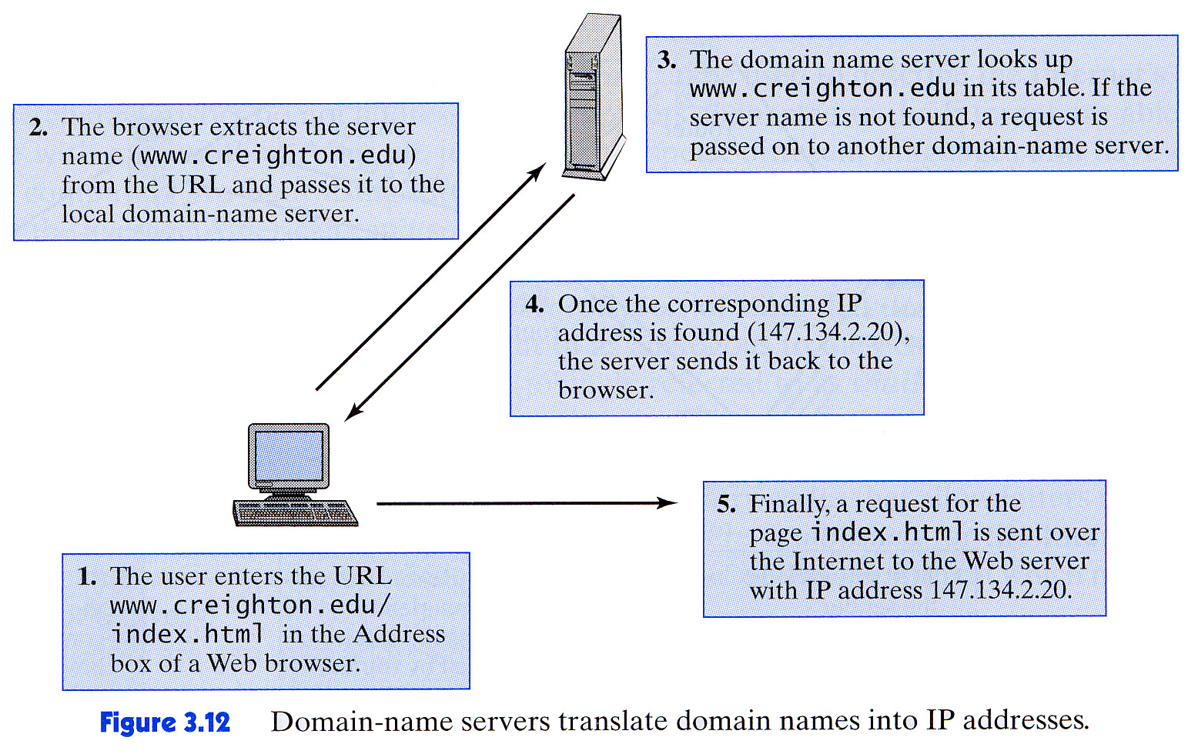
Domain Name System: Example

Slide 45
Network Organization
Computer networks are often classified according to their geographic service areas.
The smallest networks are local area networks (LANs). LANs are typically used in a single building, or a group of buildings that are near each other.
Metropolitan area networks (MANs) are networks that cover a city and its environs.
LANs are becoming faster and more easily integrated with WAN technology, it is conceivable that someday the concept of a MAN may disappear entirely.
Wide area networks (WANs) can cover multiple cities, or span the entire world.

Slide 46
Physical Network Organization
Now we’ll consider the physical network components common to LANs, MANs and WANs.
We start at the lowest level of network organization, the physical medium level.
There are two general types of communications media: guided transmission media and unguided transmission media.
Unguided media broadcast data over the airwaves using infrared, microwave, satellite, or broadcast radio carrier signals.
Guided media are physical connectors such as copper wire or fiber optic cable that directly connect to each network node.
The electrical phenomena that work against the accurate transmission of signals are called noise.

Slide 47
Physical Network Organization
Signal and noise strengths are both measured in decibels (dB).
Cables are rated according to how well they convey signals at different frequencies in the presence of noise.
The signal-to-noise rating, measured in decibels, quantifies the quality of the communications channel.
The bandwidth of a medium is technically the range of frequencies that it can carry, measured in Hertz.
In digital communications, bandwidth is the general term for the information-carrying capacity of a medium, measured in bits per second (bps).
Another important measure is bit error rate (BER), which is the ratio of the number of bits received in error to the total number of bits received.

Slide 48
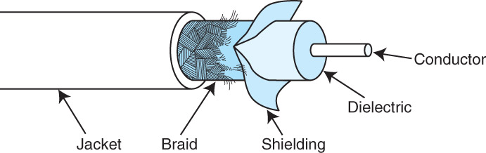
Network Cabling
Coaxial cable was once the medium of choice for data communications.
It can carry signals up to trillions of cycles per second with low attenuation (loss of signal strength).
Today, it is used mostly for broadcast and closed circuit television applications.

Slide 49
Network Cabling
Coaxial cable also carries signals for residential Internet services that piggyback on cable television lines.
The dialectric insulates the conductor, while the metallic shield and braid form two layers of protection from external electromagnetic interference

Slide 50
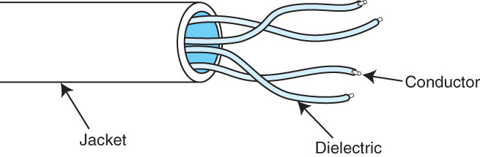
Network Cabling
Twisted pair cabling, containing two twisted wire pairs, is found in most local area network installations today.
It comes in two varieties: shielded and unshielded. Unshielded twisted pair is the most popular.
The twists in the cable help to cancel out inductance, electromagnetic interference caused by the current in the wires themselves

Slide 51
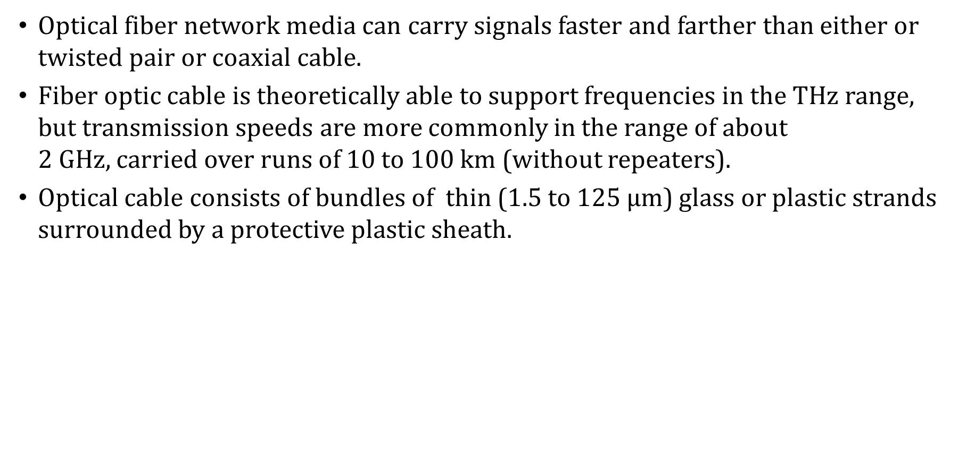
Optical Fiber
Optical fiber network media can carry signals faster and farther than either or twisted pair or coaxial cable.
Fiber optic cable is theoretically able to support frequencies in the THz range, but transmission speeds are more commonly in the range of about 2 GHz, carried over runs of 10 to 100 km (without repeaters).
Optical cable consists of bundles of thin (1.5 to 125 $μ$m) glass or plastic strands surrounded by a protective plastic sheath.

Slide 52
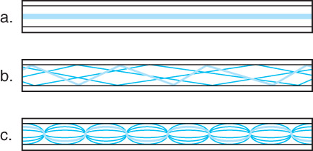
Optical Fiber
Optical fiber supports three different transmission modes depending on the type of fiber used.
Single-mode fiber provides the fastest data rates over the longest distances. It passes light at only one wavelength, typically, 850, 1300 or 1500 nanometers.
Multimode fiber can carry several different light wavelengths simultaneously through a larger fiber core.

Slide 53
Optical Fiber
Fiber optic media offer many advantages over copper, the most obvious being its enormous signal-carrying capacity.
It is also immune to electro-magnetic interference and radio frequency interference, making it ideal for deployment in industrial facilities.
Fiber optic is small and lightweight, one fiber being capable of replacing 100s of pairs of copper wires
But optical cable is fragile and costly to purchase and install. Because of this, fiber is most often used as network backbone cable, which bears the traffic of hundreds or thousands of users.
The Internet backbone consists of high-speed optical fiber, for examples

Slide 54
Wireless Networks
Unguided data communications media transmit bytes over carrier waves such as those provided by cellular telephone networks, Bluetooth, and wireless LANs.
There are others, including free space optical lasers, microwaves, and satellite communications, to name a few.
Cellular wireless networks use a cellular telephone network to transmit data.
First generation technology allowed a maximum transmission rate of around 1 Mbps.
Current generation wireless communication protocols can support transmission speeds of well over 1 Gbps

Slide 55
Cell Networks
Cell network data technology in its third generation (3G) supports transmission rates up to 2.048 Mbps
3G also supports a wide array of equipment, including the seamless integration of low-Earth-orbiting (LEO) satellites.
This technology standard is intended to possible for the entire world to have mobile web access
4G cell phone networks come in several forms, LTE (Long Term Evolution) being the most common
It supports download speeds of up to 10 times that that of 3G

Slide 56
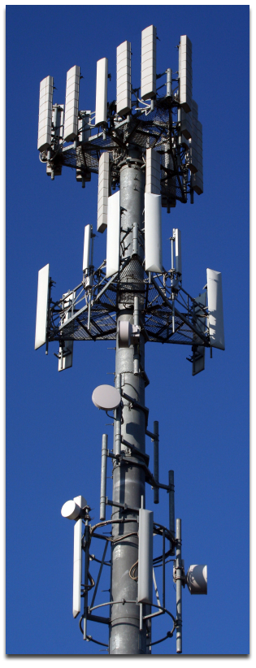
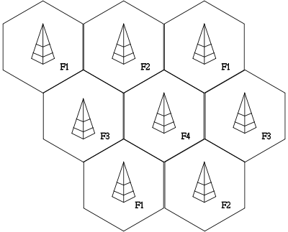
Cell Networks
Each base station uses a different set of frequencies
Multiple base stations covering a device can provide geolocation
Cell towers can re-use frequencies if they are assigned properly, as shown below

Slide 57

Bluetooth
Bluetooth was first conceived by Ericsson in 1994.
Bluetooth’s original purpose was to connect up to seven small peripheral devices with a nearby host.
Examples include mice, keyboards, printers, cameras, mobile phone headsets
The collection of these devices forms a personal area network, or piconet.
Transmission at 720 Kbps occurs over an unregulated 2.45 GHz frequency using power no greater than 100 milliwatts.
Recent versions of Bluetooth support very low energy modes to conserve power and different transmission modes to increase the transmission range of devices (but at the cost of transmission speed)
Bluetooth 5 (the latest version) is especially targeted to support the Internet of Things so that many devices in a small area can communicate easily

Slide 58
Wireless LANs
Wireless local area networks (WLANs) are generally slower than their wired counterparts, but they make up for this in their versatility.
A WLAN can be set up just about anywhere.
Several WLAN specifications are dominant in the US:
802.11g: up to 54 Mbps
802.11n: over 54 Mbps and up to 600 Mbps
802.11ac: speeds of 2 Gbps and higher are possible
The IEEE 802.11 series of standards also includes provisions for fast roaming, cellular integration, and management.
WLANs consist of a collection of wireless access points (WAPs) that broadcast to nearby computer nodes.

Slide 59
Wireless LANs
Communication distances in WLANs are limited by ambient interference and obstructions such as walls.
Connection speeds decrease as distance and obstructions increase.
Security continues to be a concern even when encrypted connections to the WAP are employed.
Some security experts believe that it is impossible to make a WLAN as secure as a wired LAN.

Slide 60
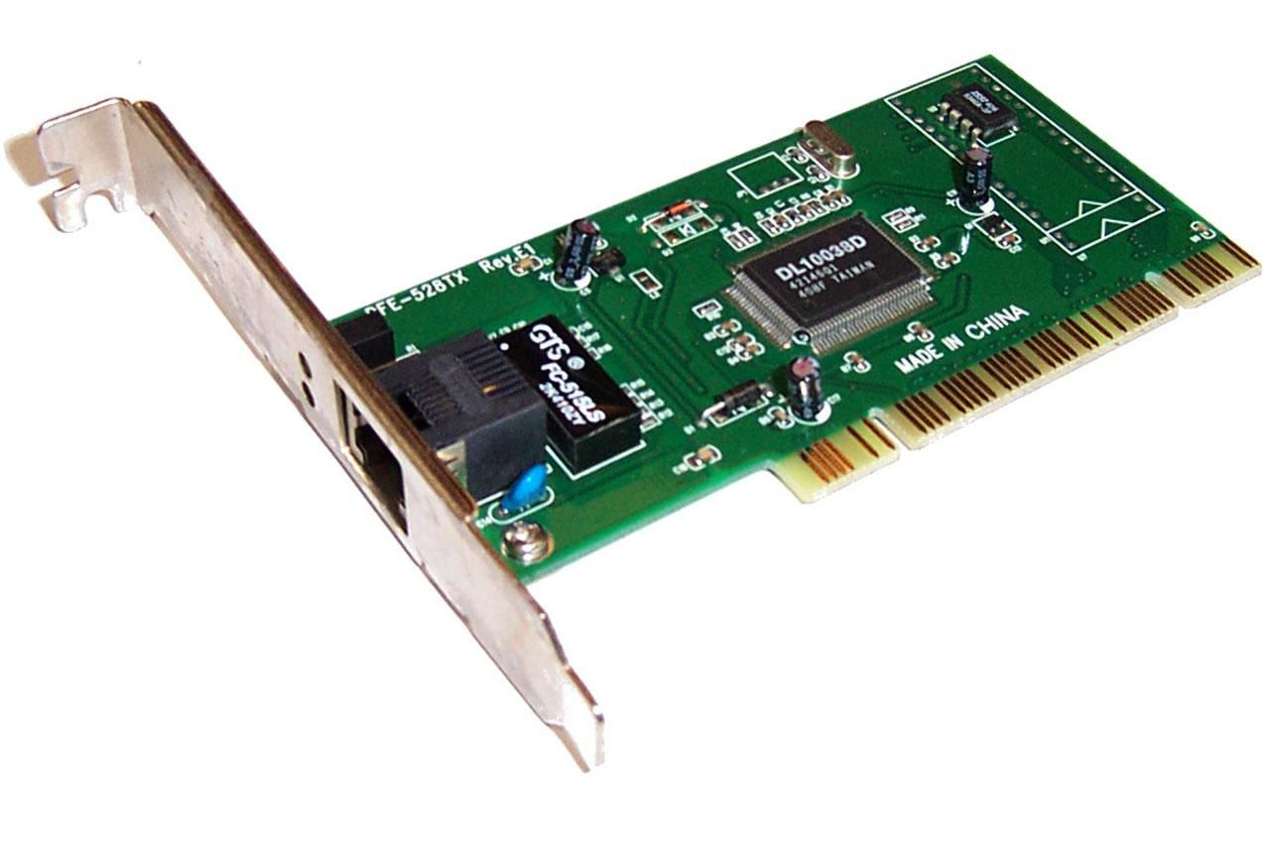
Wired Networks
Transmission media are connected to clients, hosts and other network devices through network interfaces.
Because these interfaces are often implemented on removable circuit boards, they are commonly called network interface cards, or simply NICs.
A NIC usually embodies the lowest three layers of the OSI protocol stack.
NICs attach directly to a system’s main bus or a dedicated I/O bus.
Every network card has a unique 6-byte MAC (Media Access Control) address burned into its circuits.

Slide 61
Wired Networks
Network protocol layers map this physical MAC address to at least one logical address on the network (such as an IP address).
It is possible for one computer (logical address) to have two or more NICs, but each NIC will have a distinct MAC address.
One of the new aspects of IPv6 is to allow autoconfiguration of computers on the network by using their MAC addresses
This will make it easier for network administrators to permit new machines to enter the network without having to assign new IP addresses
Or likewise, it will make it easier to move machines to different networks – the computer does not need to be assigned a new IP address because address assignment will happen automatically using the MAC address

Slide 62
Ethernet
Ethernet is the dominant technology for building wireless local area networks
Ethernet works at the Data Link layer (layer 2)
Older version of Ethernet use a Carrier Sense Multiple Access / Collision Detection (CSMA/CD) medium access control
Before attempting to transmit, the network interface checks if the communication medium is available
If not, it waits for a period of time and tries again
If two parties attempt to communicate simultaneously, a collision occurs, which is detected by both stations

Slide 63
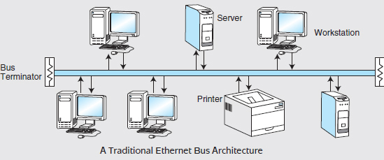
Ethernet
Older Ethernet networks were configured in a bus-style fashion and supported 10 Mbps:

Slide 64
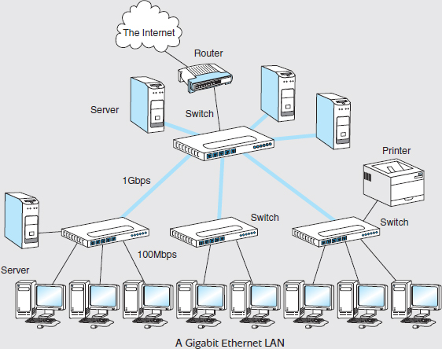
Ethernet
A collision is detected by a higher-than-normal voltage on the bus
All stations see all communication across the bus and so look for their own addresses in frames, ignoring frames intended for other machines
This is all “old-style” Ethernet
Modern Ethernet networks use switches to route traffic across the LAN and support (in theory) transmission rates up to 1 Gbps
The switches control the medium, so collision detection across a shared bus is no longer required

Slide 65
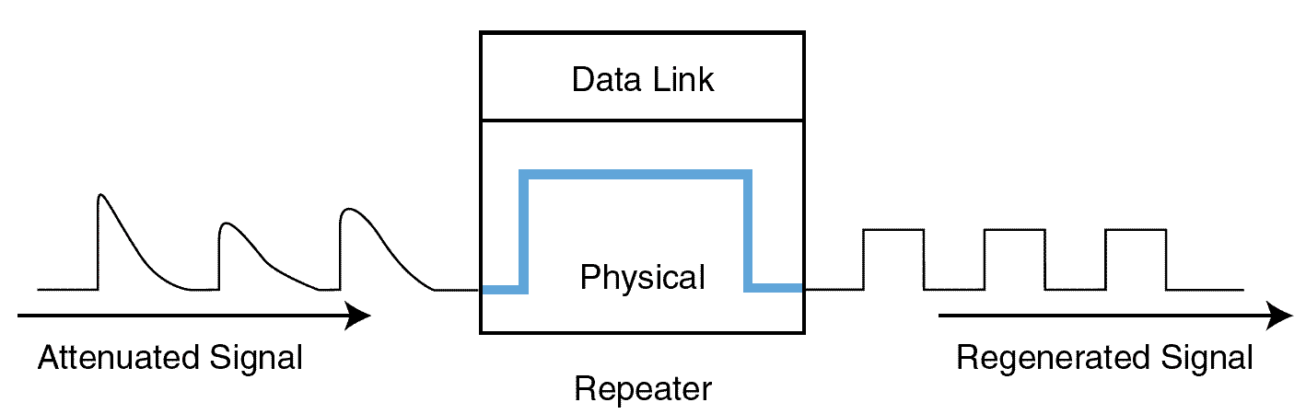
Other Networking Hardware: Repeaters
Signal attenuation in wireless and wired networks is corrected by repeaters that amplify signals in physical cabling.
Repeaters are part of the network medium (Layer 1).
In theory, they are dumb devices functioning entirely without human intervention. However, some repeaters now offer higher-level services to assist with network management and troubleshooting.

Slide 66
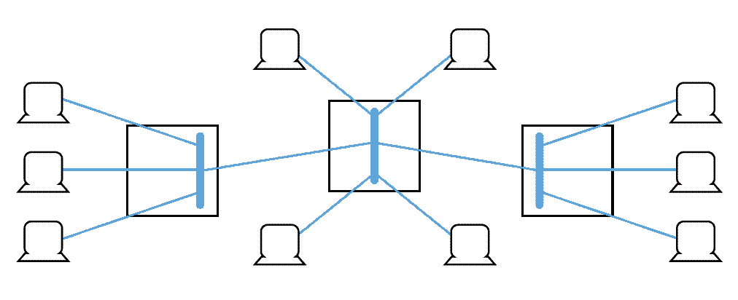
Other Networking Hardware: Hubs
Hubs are also Physical layer devices, but they can have many ports for input and output.
They receive incoming packets from one or more locations and broadcast the packets to one or more devices on the network.
Hubs allow computers to be joined to form network segments.

Slide 67
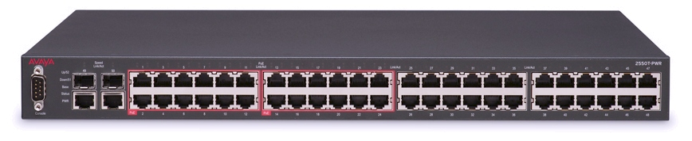
Other Networking Hardware: Switches
A switch is a Data Link layer device that creates a point-to-point connection between one of its input ports and one of its output ports.
Switches contain buffered input ports, an equal number of output ports, a switching fabric and digital hardware that interprets address information encoded on network frames as they arrive in the input buffers.
Because all switching functions are carried out in hardware, switches are the preferred devices for interconnecting high-performance network components.

Slide 68
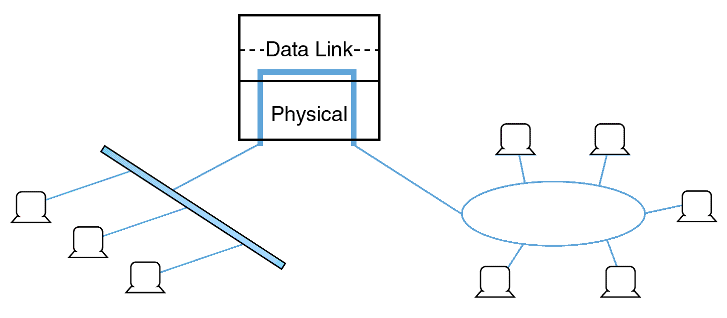
Other Networking Hardware: Bridges
Bridges are Data Link layer devices that join two similar types of networks so they look like one network.
Bridges are “store and forward” devices – they hold an entire frame before forwarding it to the destination
Bridges also validate addresses so that only data being sent to a valid address is able to cross the bridge

Slide 69
Other Networking Hardware: Gateways
Related to bridges are gateways
Unlike a bridge, a gateway can connect two networks that use different protocols
A gateway could be a fully functional computer that can convert data types, provide encryption and decryption, and operate at any of the 7 OSI layers
On home networks, a residential gateway typically serves as the network gateway
A cable/DSL modem or wireless access point (or some combination thereof) could serve this purpose

Slide 70
Other Networking Hardware: Routers
A router is a device connected to at least two networks that determines the destination to which a packet should be forwarded.
Routers are designed specifically to connect two networks together, typically a LAN to a WAN.
Routers are Network layer devices. They can bridge different network media types and connect different network protocols running at Layer 3 and below.
Routers are sometimes referred to as “intermediate systems” in Internet standards literature.
Routers are complex devices because they contain buffers, switching logic, memory, and processing power to calculate the best way to send a packet to its destination.

Slide 71
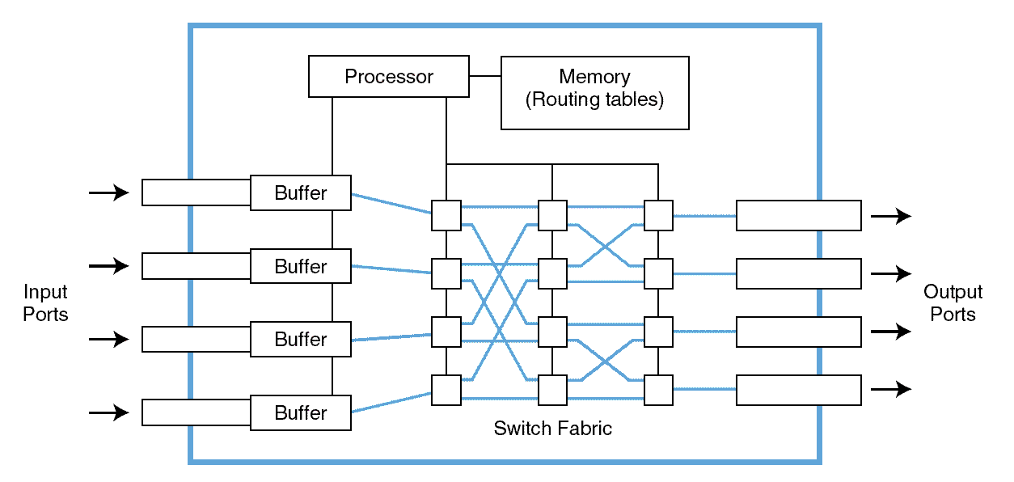
Other Networking Hardware: Routers

Slide 72
Other Networking Hardware: Routers
Small networks might employ static routing, wherein each router is manually programmed to route packets across a network
If a router fails, the network becomes disconnected, requiring human intervention
Dynamic routers automatically set up routes and respond to the changes in the network.
They explore their networks through information exchanges with other routers on the network.
The information packets exchanged by the routers reveal their addresses and costs of getting from one point to another.
Using this information, each router assembles a table of values in memory called a routing table.

Slide 73
Other Networking Hardware: Routers
Typically, each destination node is listed along with the neighboring, or next-hop, router to which it is connected.
When creating their routing tables, dynamic routers consider one of two metrics:
They can use either the distance to travel between two nodes in terms of number of hops, or
They can use the condition of the network in terms of measured latency.
The algorithms using the first metric are distance vector routing algorithms. Link-state routing algorithms use the second metric.

Slide 74
Network Address Translation
Network Address Translation (NAT) is a scheme for sharing a single IP address among several devices connected to the same router (like the router in your home/dorm)
The devices have private IP addresses in the LAN, with the router having a public IP address assigned by the Internet Service Provider (ISP)
NAT is accomplished by having the router modify the IP packets themselves
The source IP addresses of outgoing packets are changed from the private addresses to the public address
The destination IP addresses of incoming packets are changed from the public address to the correct private addresses
The NAT router tracks information about each active connection (including ports, which might be modified also) so it knows how to perform the public/private mappings

Slide 75
Firewalls
Firewalls are systems (software or hardware) that seek to protect networks from harmful traffic
They can be host-based (on your computer) or installed on the router (hardware-based, and therefore, faster than host-based)
A firewall is programmed with a policy, which contains rules that state which network addresses have access to which services
For example, a firewall installed at a library might have a policy to block access to objectionable content on the Internet
Most people think of firewalls as protecting a network from outside attacks, such as by using blacklists to prevent content from identified external hosts from reaching the network
Can you think of reasons why a firewall might be programmed to prevent certain outgoing traffic?

Slide 76
The Fragility of the Internet
Practically everyone understands that the Internet is crucial to global commerce.
What is less clear is the importance of the Internet to the health and safety of the modern world.
SCADA (supervisory control and data acquisition) systems operate vital portions of our physical infrastructure including power generation, transportation networks, sewage systems, oil and gas pipelines
These systems are increasingly the targets in cyber warfare
Reliance on the Internet as a physical infrastructure is only going to increase with the Internet of Things (IoT) communication (e.g., smart appliances, home security systems, etc.)
Cisco estimates 50 billion sensor nodes by 2020

Slide 77
The Fragility of the Internet
Can the Internet deal with this traffic? Congestion collapse is a concern: routers become overwhelmed (congested), reroute packets to other routers which then become overwhelmed in cascading fashion.
The ultimate fix is to make the Internet “smarter” by improving the routing algorithms.
TCP does its best with its congestion control algorithms to avoid congestive collapse, but it can do only so much.

Slide 78
The World Wide Web
Invented by Tim Berners-Lee in late 1980s
Wanted an easy way of sharing documents over the Internet
Combined the idea of hypertext (text with links to other text) with the Internet
Created initial designs of web servers and web browsers
The Web is essentially an application of the Internet – the Web relies on the underlying hardware and software infrastructure of the Internet to move data between web browsers (clients) and web servers

Slide 79
The World Wide Web
HyperText Transfer Protocol is used to communicate between Web browsers and servers
The web browser formats its message according to HTTP
The web server sends back the web page in HTTP format
The web browser renders the web page for viewing
Some important computer languages of the web include:
HyperText Markup Language (HTML): used to provide the general structure and content of a web page (text, paragraphs, lists, images, tables, etc.)
Cascading Style Sheets (CSS): used to provide the layout and styling of the web page (colors, fonts, etc.)
Neither is a programming language

Slide 80
The World Wide Web
When a web browser makes a request to a web server for a web page via a Uniform Resource Locator, the downloaded files could include HTML files, CSS files, images, video clips, short programs, among other kinds of data
JavaScript is a very popular programming language for adding dynamic content to web pages
Can make web pages interactive and responsive to the user
Dynamically update the content of a web page based on user input
Perform data processing of information entered by the user in a form
Make queries on a database to retrieve data asynchronously and perform other tasks in an asynchronous fashion
Create animations, special effects

Slide 81
The World Wide Web: Search Engines
Search engines like Google rely heavily on web crawlers
A web crawler is a bot that “crawls” the web, following hyperlinks in web pages
Its purpose is to help build an index of web pages so that when a person enters a search term at the search engine, the index can be queried for websites relevant to the search term
PageRank is one of Google’s algorithm for ranking pages in web searches
Google’s own summary of how PageRank works:
PageRank works by counting the number and quality of links to a page to determine a rough estimate of how important the website is. The underlying assumption is that more important websites are likely to receive more links from other websites.

Slide 82
Web Application Architecture
A modern web application is a pretty complicated piece of software with several major components
The front end is the set of components that the user interacts with. It consists of a lot of HTML, CSS and JavaScript code.
The back end consists of the database and the database server, which provides the data to be viewed on the front end.
In between the two we find middleware, which connects the front end and back end. It transforms user interaction into requests to the database. In turn, data from the database is transformed by the middle layer into a form that can be displayed by the front end.
The middle layer contains the business logic, and is application-dependent.

